Slide 1

AFROBIZGERMANY
Bringing it home

Slide 2

Miss-information

Slide 3
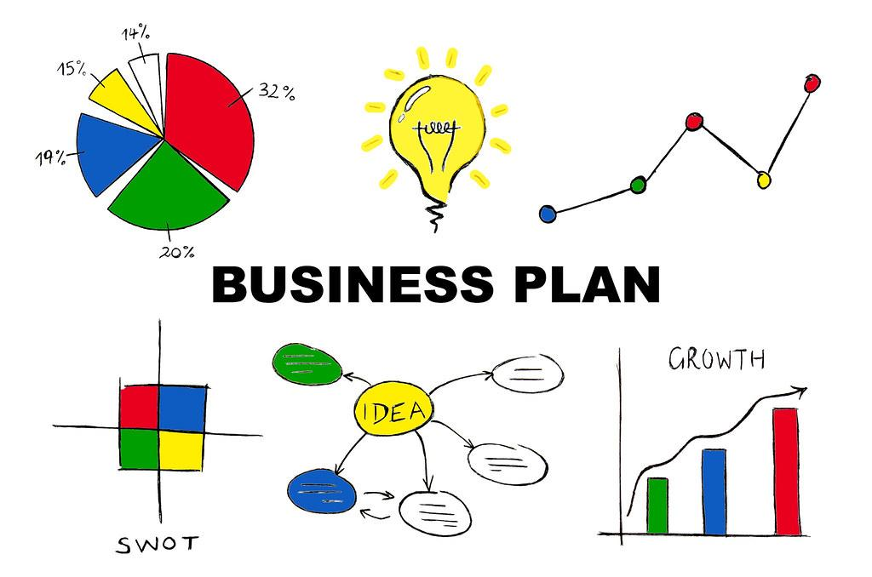
How and Method

Slide 4

Should money be a reason not to start?

Slide 5
EVENT - Afro-Bloggers Convention

Slide 6
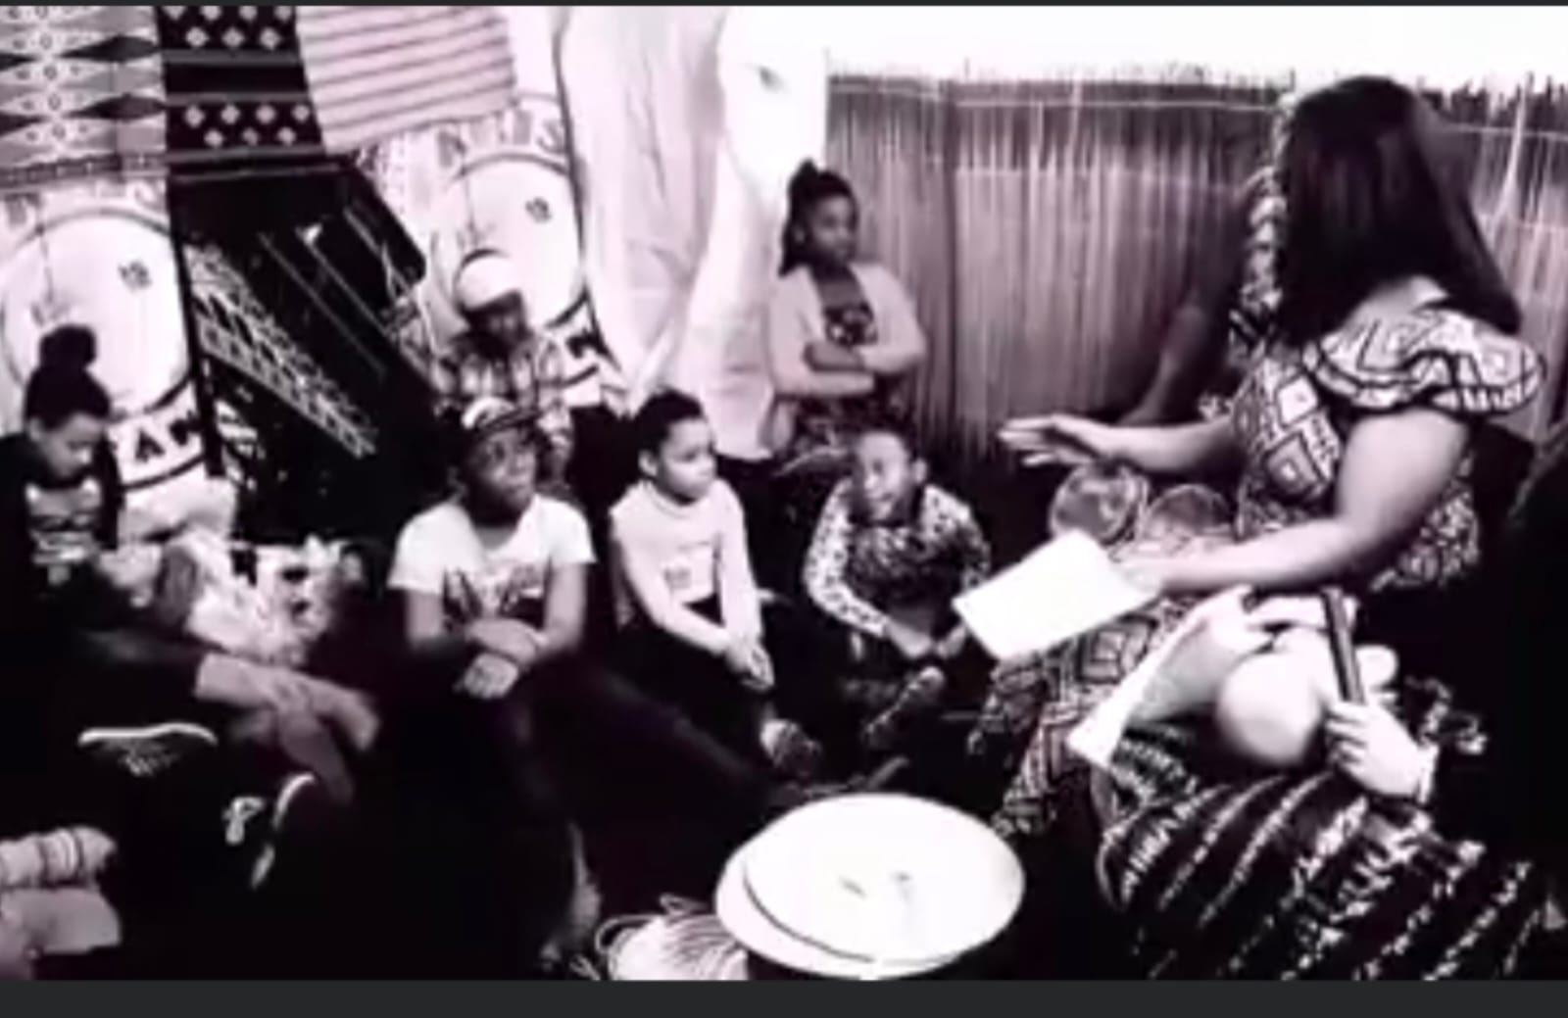

Community Service

Slide 7
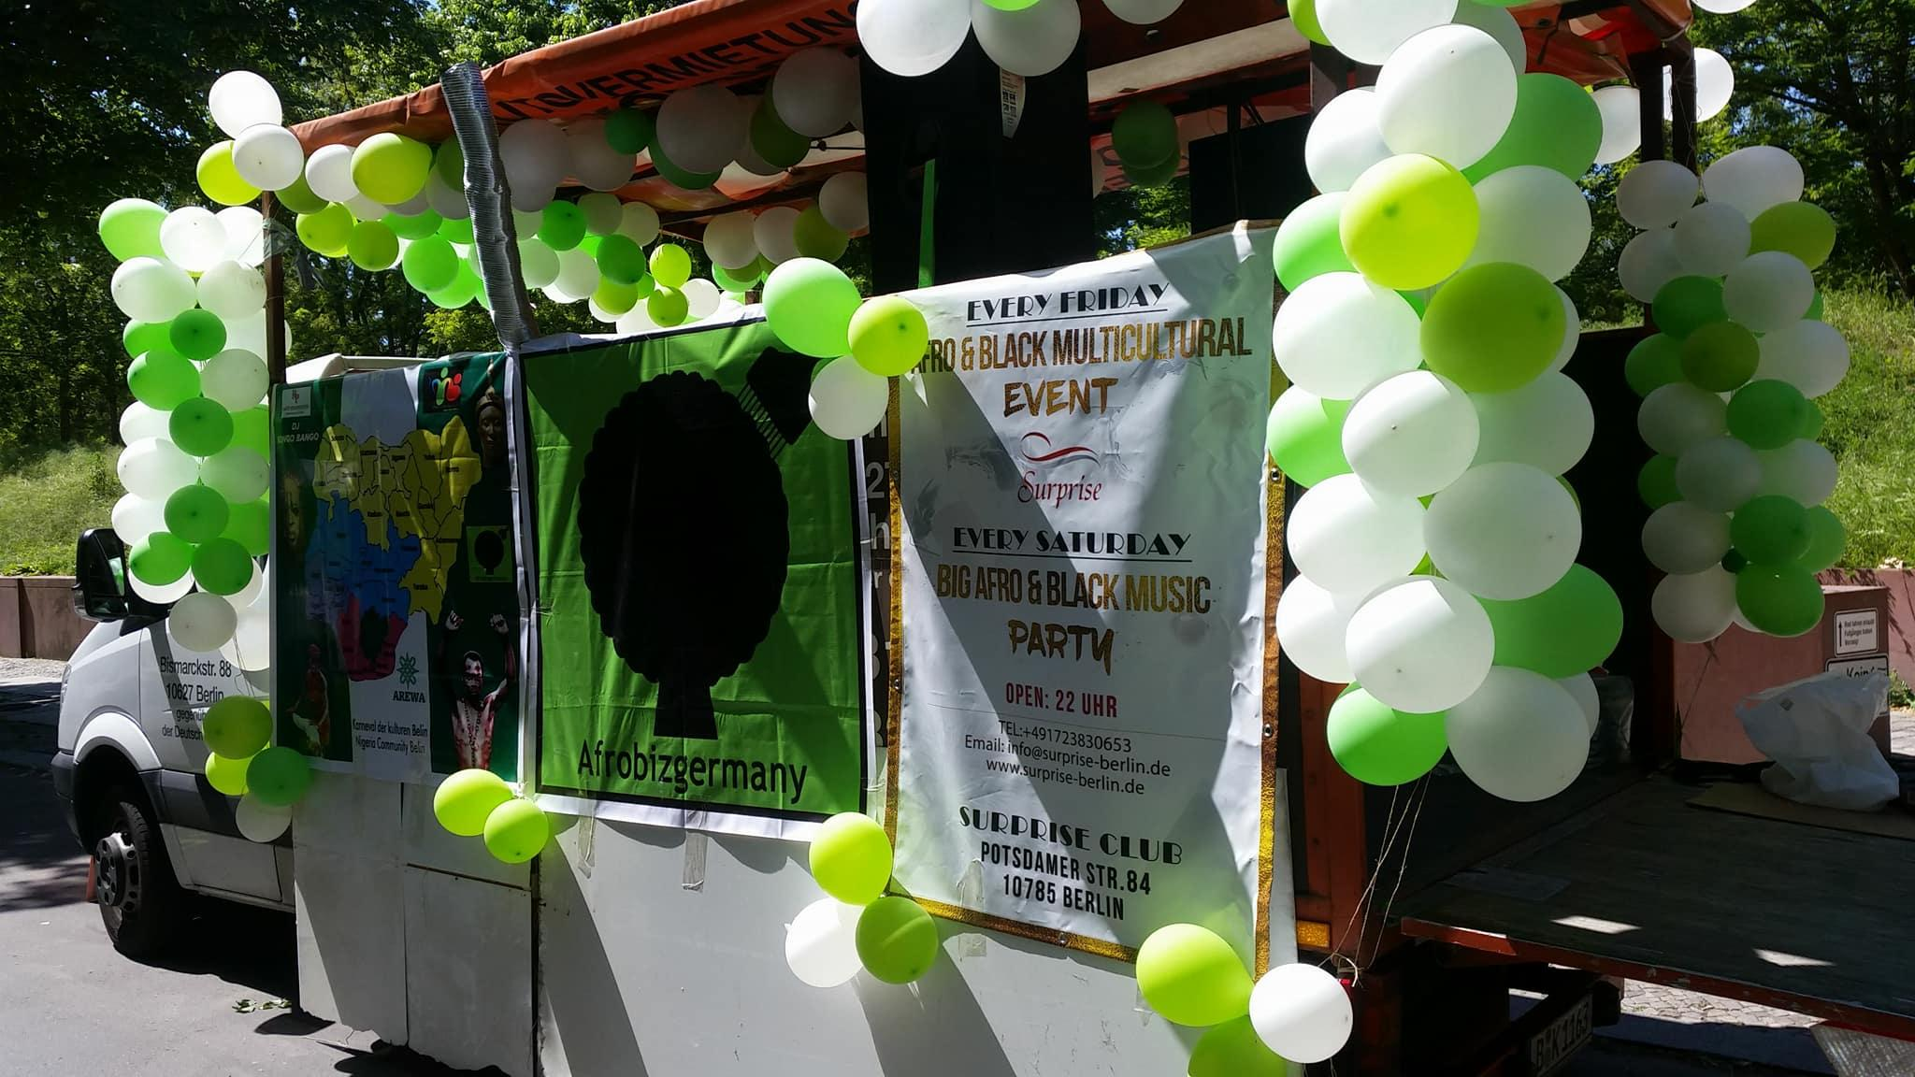
Organise and Partake in Cultural Activity

Slide 8

Film Production

Slide 9
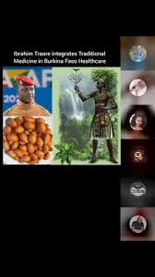
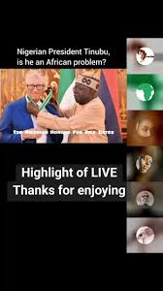
Pan-African Worldwide TiTok Live Panel

