Slide 1

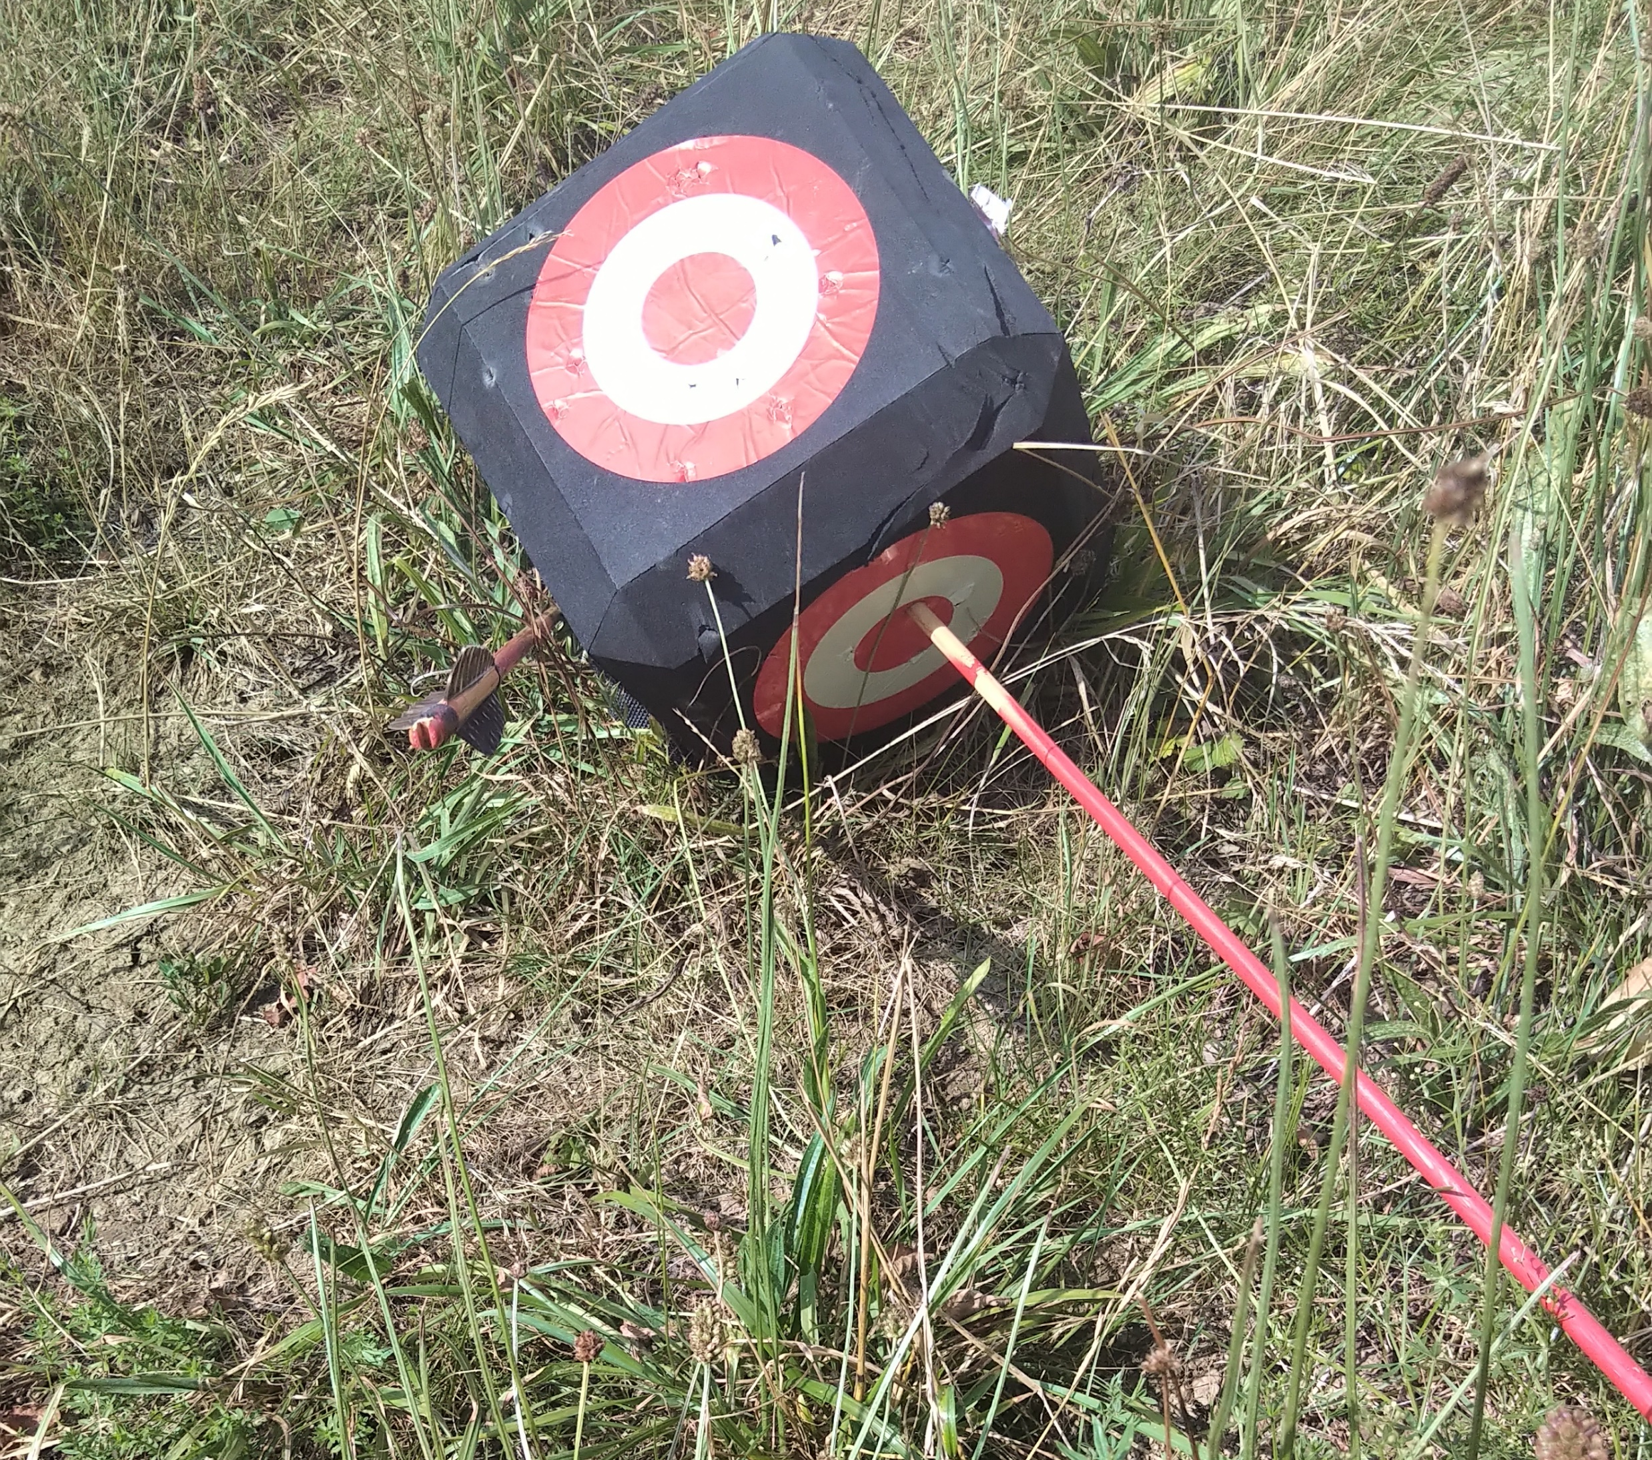
Smart investing and financial habits for tomorrow´s CEOs
Oliver Stede
Financial and Insurance Broker
www.oliverstede.de
Registration D-AOOH-I7HIZ-37 / D-F-175-TZEU-30
Disclaimer
The presentation is not investment advice.
Each recommendation requires a special analysis.

Slide 2
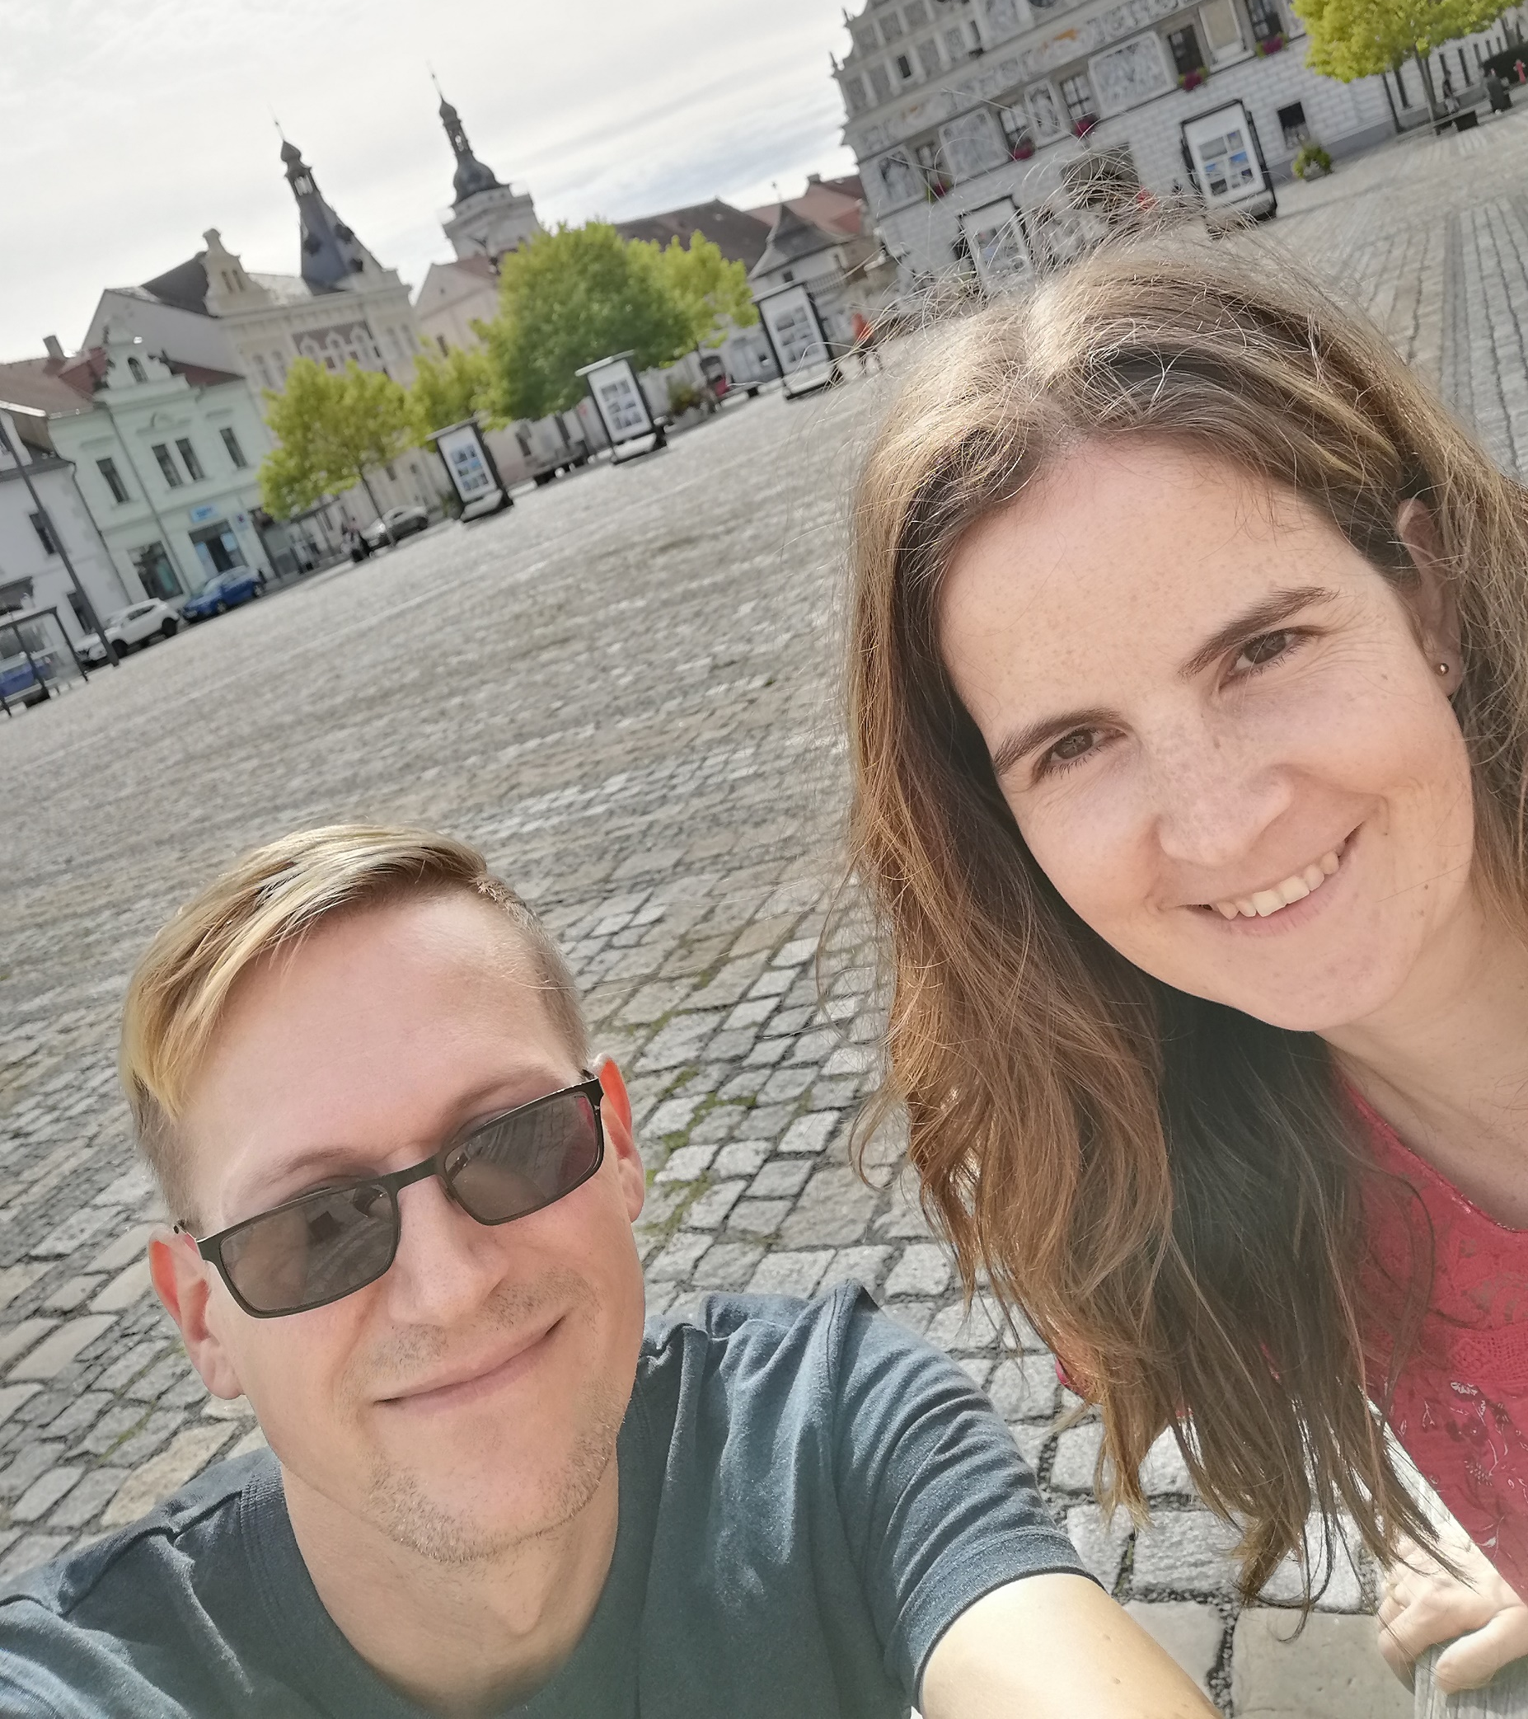
Oliver Stede
45 years old
born in Thuringia , middle Germany
Göppingen (between Stuttgart- Ulm)
married
business - relationship manager
hobbies - bow shooting, hiking, traveling
interests - politics, economy, history, religion and culture
honorary position – priest in church (NAC Göppingen)

Slide 3
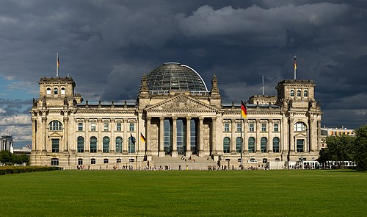
economic cycle
consumer
state
taxes
citizens subsidies
subsidies/ taxes
money
interest / rate
- inflation
investment
banks
insurances
building society
economy / companies
return / yield

Slide 4
investment
consumer
state
investment
return / yield
banks
insurances
building society
economy / companies

Slide 5
Problem
poor / middle class | rich people / elite class
bank savings plans | investment funds / insurances
classic life insurance | commodity investments (silver, gold, oil, rare earths, wood, water)
bad credits (consumer loans) | good credits (real estate loans)
no money for good advice | connections and volume to institutional asset classes and private equity
mindset
get rich | stay rich
investment style
too agressive | too conservative

Slide 6
Money does not make you happy
Money alone does not make you happy, you should also have stocks, gold, and land
US Comedian Danny Kaye
18. 01. 1911- 03.03 1987

Slide 7
asset triangle
return / yield
security
availability

Slide 8
asset triangle
return / yield
security
availability

Slide 9


asset triangle
return / yield
security
availability

Slide 10

asset triangle
return / yield
security
availability

Slide 11
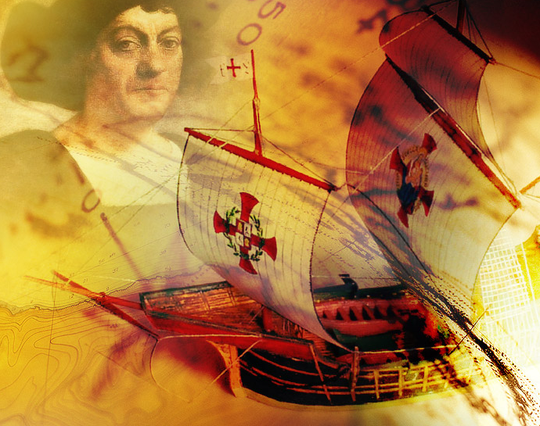
risk spreading

Slide 12
Ships
Santa Maria
Pinta
Niña
carrack
caravel
caravel

Slide 13

Ships – asset classes
Santa Maria
Pinta
Niña
carrack
caravel
caravel

Slide 14
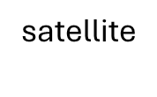
Ships – asset classes
Santa Maria
Pinta
Niña
carrack
caravel
caravel
core
satellite

Slide 15

assets
money market fund
bond fund
real estate funds
equity fund
multi asset
private equity
raw materials fund

Slide 16
Ships – asset classes
Santa Maria
Pinta
Niña
carrack
caravel
caravel
core
satellite

Slide 17
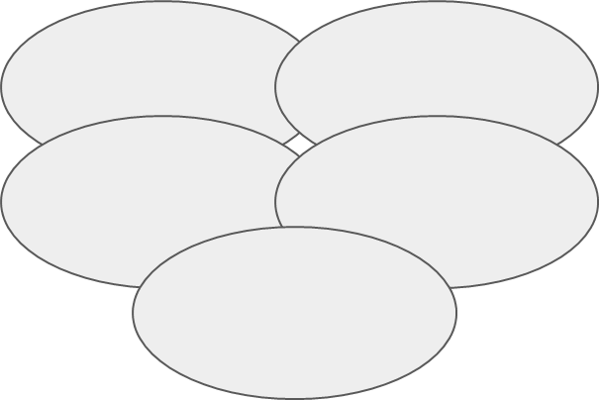
your risk - human labour

Slide 18
your risk - human labour
occupational incapacity

Slide 19
your risk - human labour
occupational incapacity
dread disease

Slide 20
your risk - human labour
occupational incapacity
dread disease
accident

Slide 21
your risk - human labour
occupational incapacity
dread disease
accident
care

Slide 22
your risk - human labour
occupational incapacity
dread disease
accident
care
death

Slide 23
Problems - Solutions
property insurance | biometric risks | investments
b to c b to b | - occupational disability insurance accident insurance dread disease life insurance | capital accumulation
company retirement scheme / pension savings plan | health insurance | network
b to c b to b | statutory health insurance providers / private health insurance | tax consultant lawyer

Slide 24
Costs
knowledge counts
two parts of income
brokerage
service fee
small office
biggest costs car, it-systems
do small steps, grow healthy

Slide 25

Questions

Slide 26

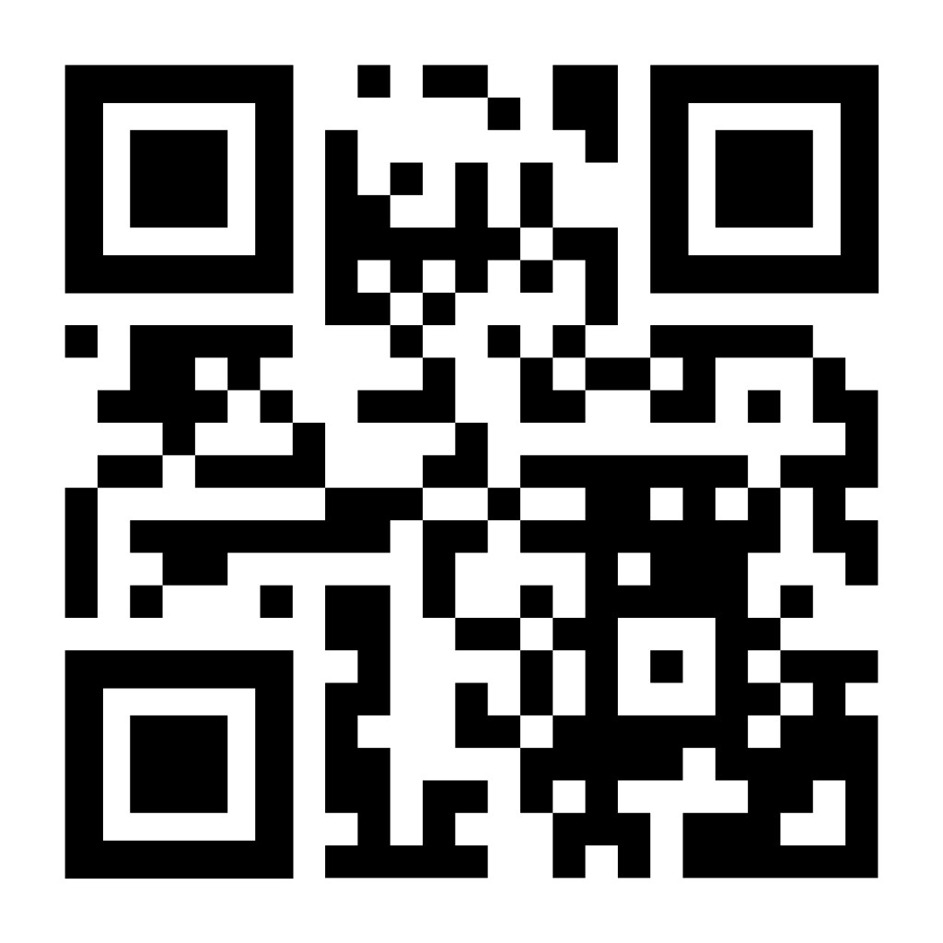
thank you for your invitation

